Slide 1
Machine Learning Final Project
Fathima Kamaludeen
Justin Landay
Vijayshri Rangasamy

Slide 2
Data
We chose to use the STL-10 dataset for our project which was made available by stanford (https://cs.stanford.edu/~acoates/stl10/) .
96x96 pixels color image
10 classes: airplane, bird, car, cat, deer, dog, horse, monkey, ship, truck.
Training : contains 500 labelled images per class
Testing : 800 images per class.

Slide 3
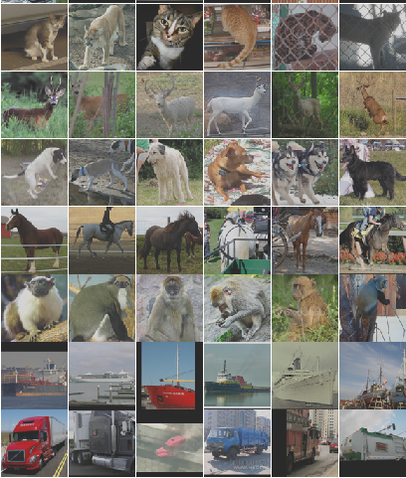
Sample Images

Slide 4
MLP

Slide 5
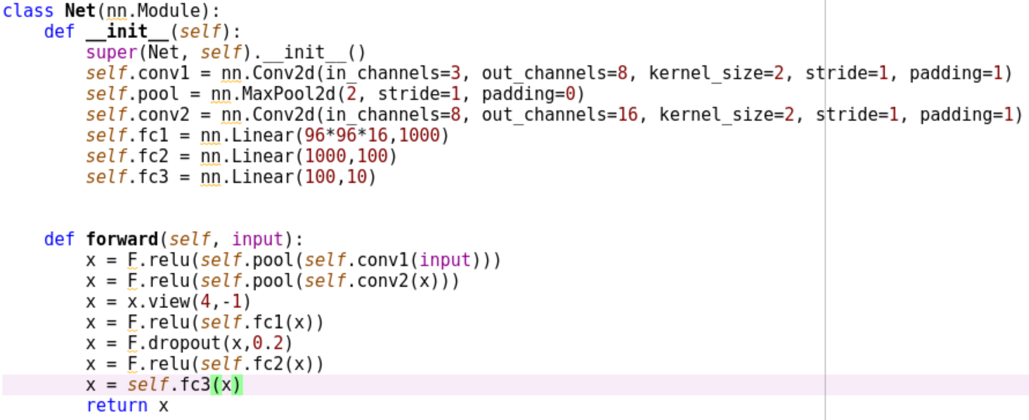
CNN 1 Architecture

Slide 6
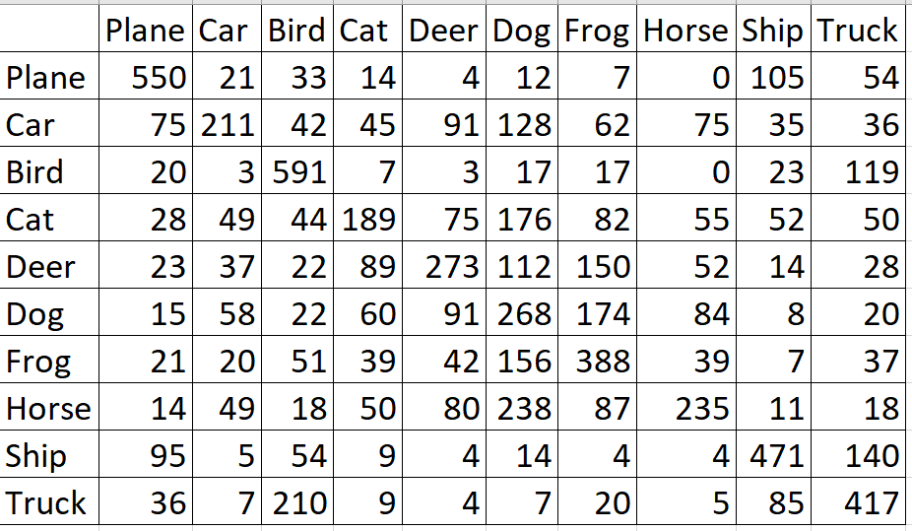
CNN 1 Results
99% Training Accuracy, 44% Test Accuracy

Slide 7
CNN 2

Slide 8
Conclusions

